Slide 1
Properties of
Regular Languages

Slide 2




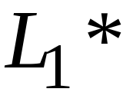
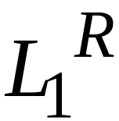


For regular languages and
we will prove that:
Union:
Concatenation:
Are regular
Languages
Star:
Reversal:
Complement:
Intersection:

Slide 3
We say: Regular languages are closed under
Union:
Concatenation:
Star:
Reversal:
Complement:
Intersection:

Slide 4
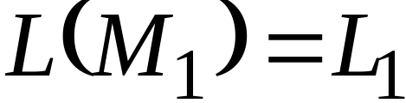
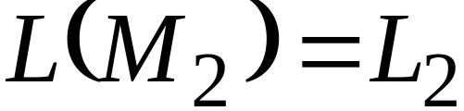


Regular language
Regular language
NFA
NFA
Single final state
Single final state

Slide 5


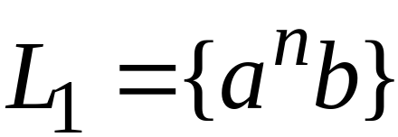

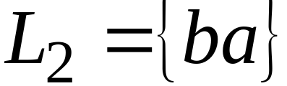
Example

Slide 6

Union
NFA for

Slide 7
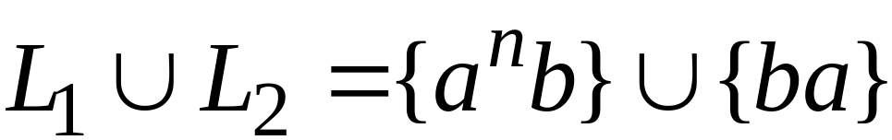
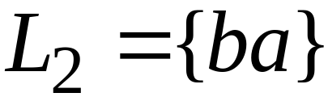
Example
NFA for

Slide 8
Concatenation
NFA for

Slide 9
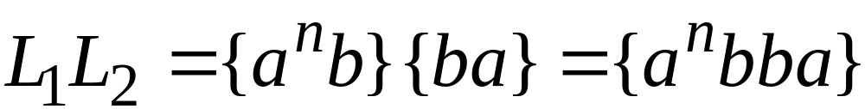
Example
NFA for

Slide 10
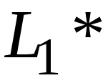
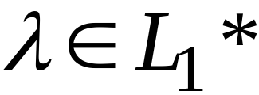
Star Operation
NFA for

Slide 11
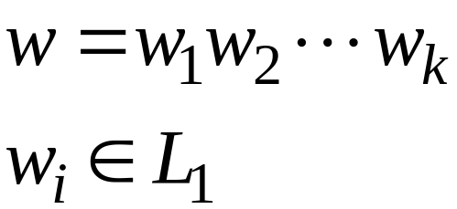
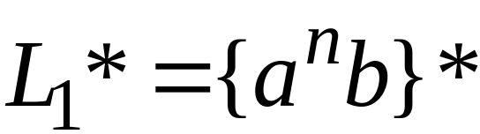
Example
NFA for

Slide 12

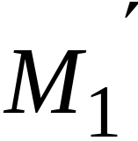
Reverse
NFA for
1. Reverse all transitions
2. Make initial state final state
and vice versa

Slide 13
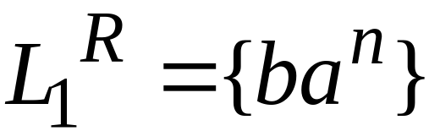
Example

Slide 14
Complement
1. Take the DFA that accepts
2. Make final states non-final,
and vice-versa

Slide 15

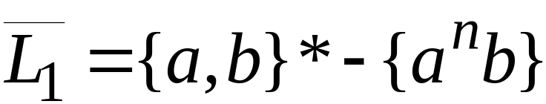
Example

Slide 16




Intersection
DeMorgan’s Law:
regular
regular
regular
regular
regular

Slide 17
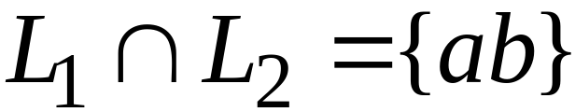
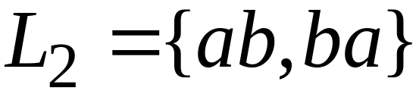
Example
regular
regular
regular

Slide 18
Regular Expressions

Slide 19
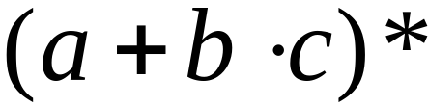
Regular Expressions
Regular expressions
describe regular languages
Example:
describes the language

Slide 20
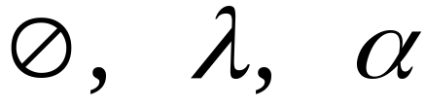



Recursive Definition
Primitive regular expressions:
Given regular expressions and
Are regular expressions

Slide 21
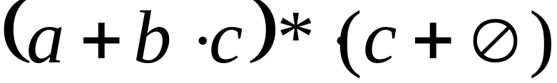
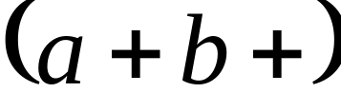
Examples
A regular expression:
Not a regular expression:

Slide 22
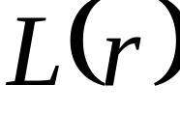

Languages of Regular Expressions
: language of regular expression
Example

Slide 23
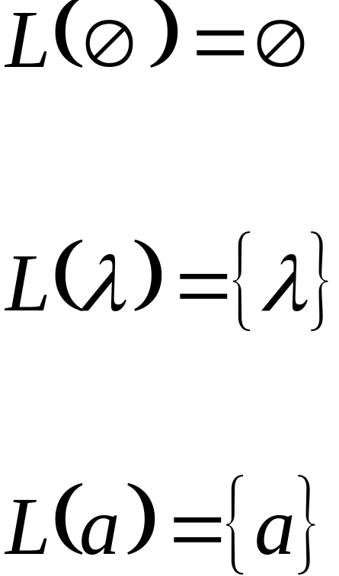
Definition
For primitive regular expressions:

Slide 24


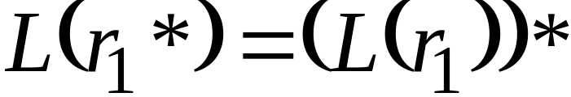

Definition (continued)
For regular expressions and

Slide 25

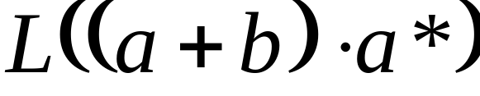


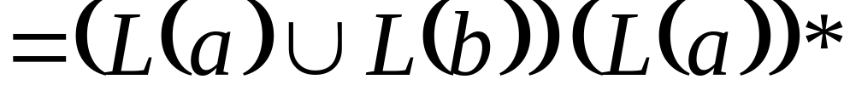
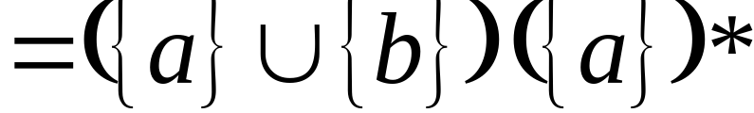
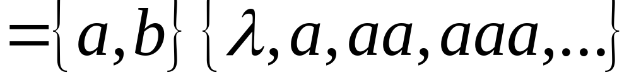
Example
Regular expression:

Slide 26

Example
Regular expression

Slide 27


Example
Regular expression

Slide 28


Example
Regular expression
= { all strings with at least
two consecutive 0 }

Slide 29
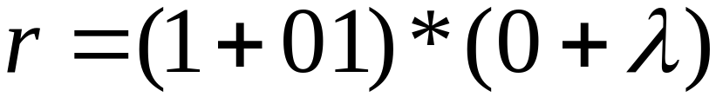
Example
Regular expression
= { all strings without
two consecutive 0 }

Slide 30

Equivalent Regular Expressions
Definition:
Regular expressions and
are equivalent if

Slide 31

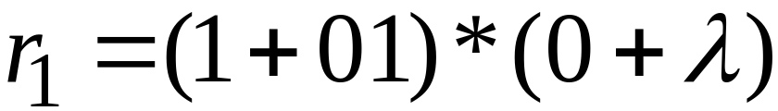

Example
= { all strings without
two consecutive 0 }
and
are equivalent
regular expr.

Slide 32
Regular Expressions and
Regular Languages

Slide 33

Theorem
Languages
Generated by
Regular Expressions
Regular
Languages

Slide 34
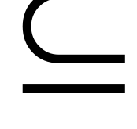
Theorem - Part 1
Languages
Generated by
Regular Expressions
Regular
Languages
1. For any regular expression
the language is regular

Slide 35

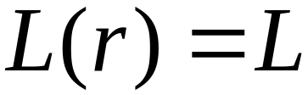
Theorem - Part 2
Languages
Generated by
Regular Expressions
Regular
Languages
2. For any regular language there is
a regular expression with

Slide 36
Proof - Part 1
1. For any regular expression
the language is regular
Proof by induction on the size of

Slide 37
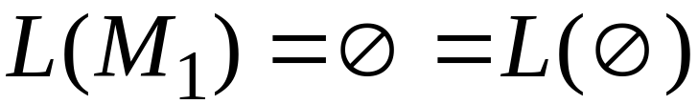
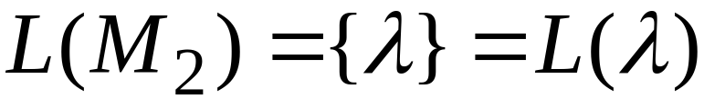

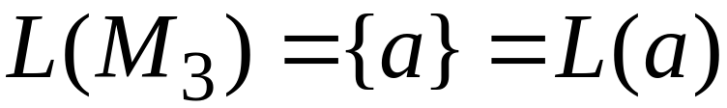
Induction Basis
Primitive Regular Expressions:
NFAs
regular
languages

Slide 38
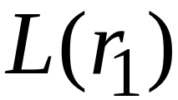
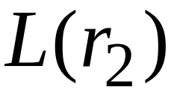
Inductive Hypothesis
Assume
for regular expressions and
that
and are regular languages

Slide 39
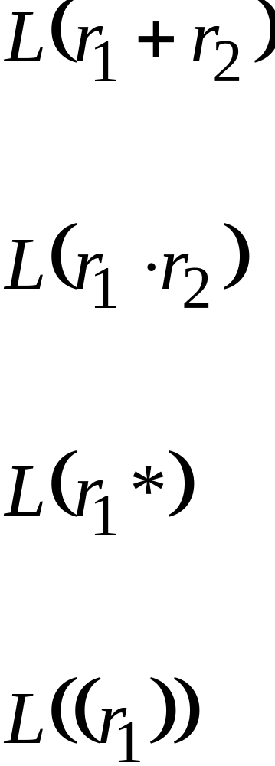
Inductive Step
We will prove:
Are regular
Languages

Slide 40
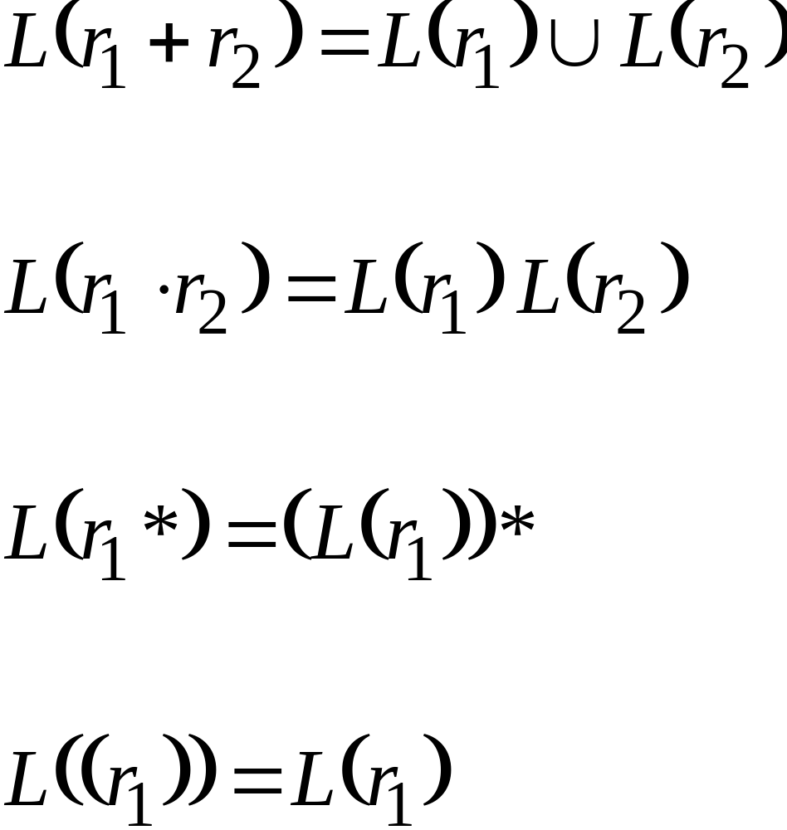
By definition of regular expressions:

Slide 41
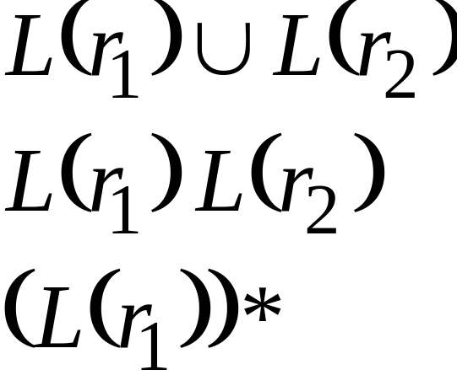
By inductive hypothesis we know:
and are regular languages
We also know:
Regular languages are closed under:
Union
Concatenation
Star

Slide 42
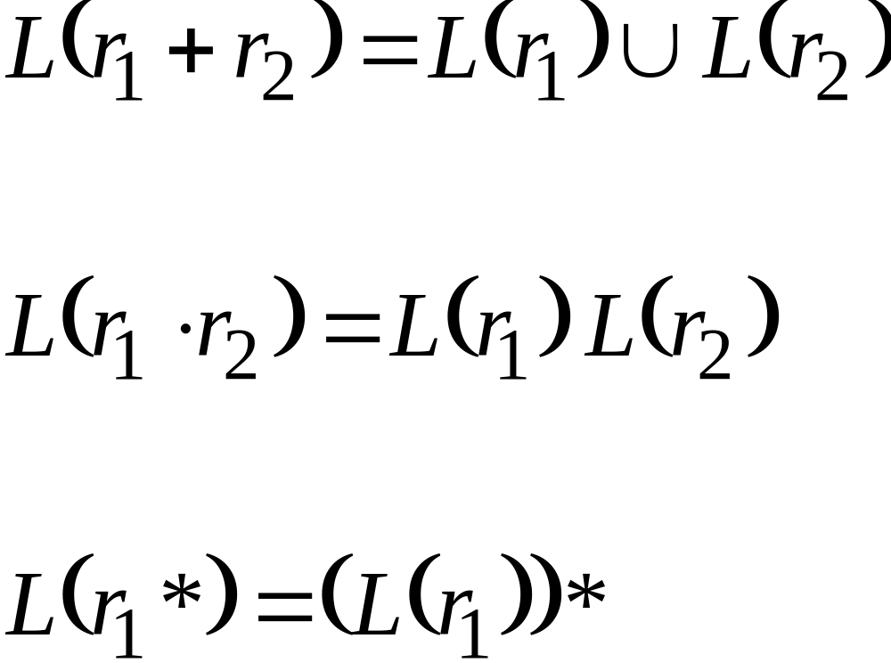
Therefore:
Are regular
languages

Slide 43
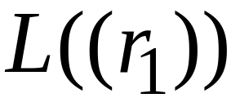
And trivially:
is a regular language

Slide 44
Proof – Part 2
2. For any regular language there is
a regular expression with
Proof by construction of regular expression

Slide 45

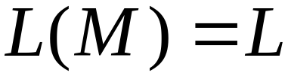
Since is regular take the
NFA that accepts it
Single final state

Slide 46



From construct the equivalent
Generalized Transition Graph
in which transition labels are regular expressions
Example:

Slide 47



Another Example:

Slide 48

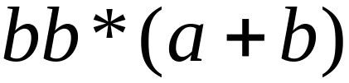
Reducing the states:

Slide 49
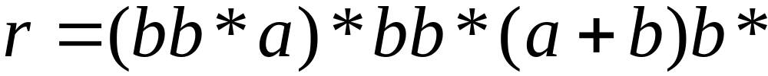
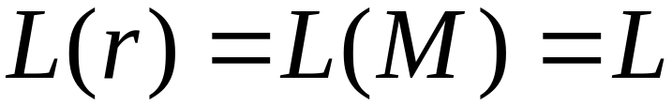
Resulting Regular Expression:

Slide 50









In General
Removing states:

Slide 51





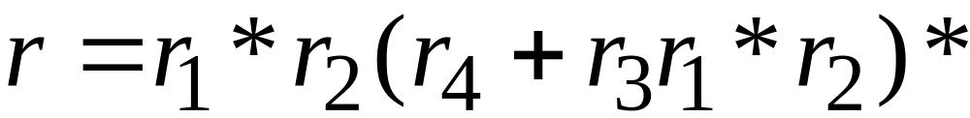
The final transition graph:
The resulting regular expression:

